Slide 1

Creating Web Applications(MVC)
Muhammed

Slide 2
Tutorial
https://learn.microsoft.com/en-us/aspnet/core/tutorials/first-mvc-app/start-mvc?view=aspnetcore-7.0&tabs=visual-studio

Slide 3
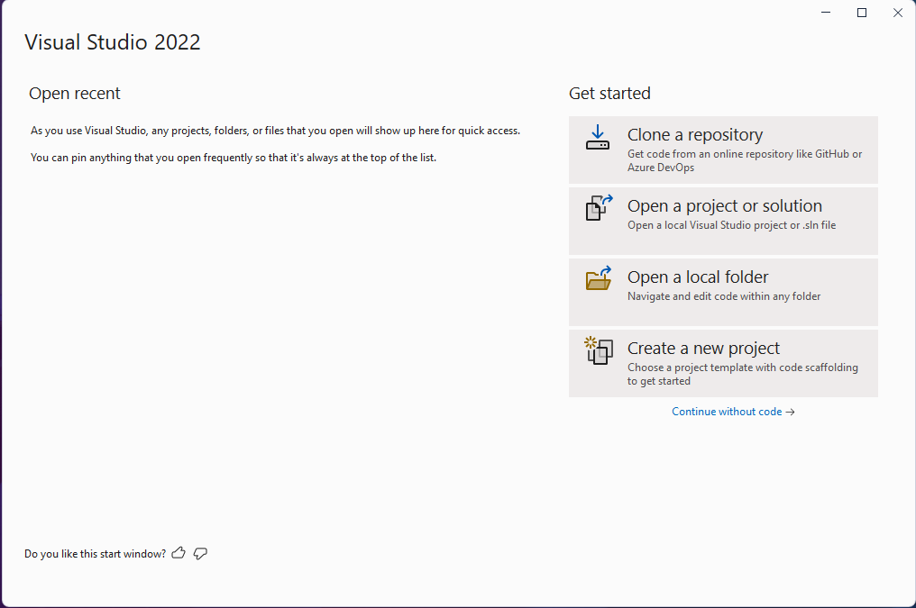
Step 1- Open Visual Studio – Create a New Project

Slide 4
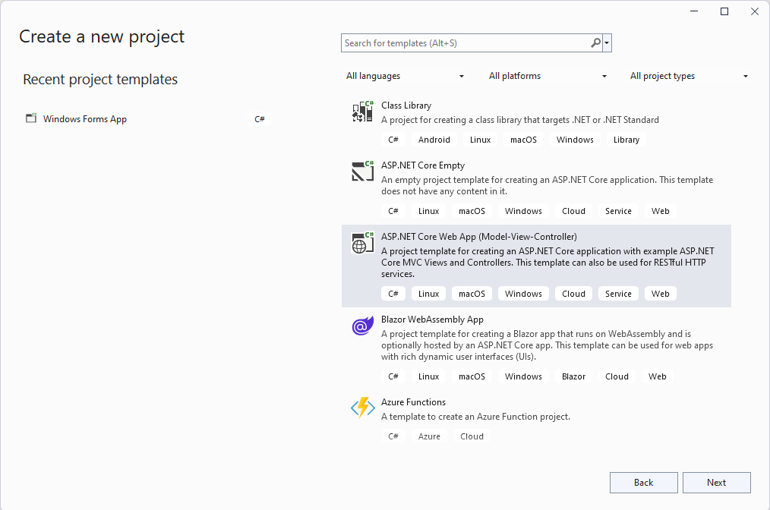
Select ASP.Net Core Web App (Model-View-Controller)

Slide 5
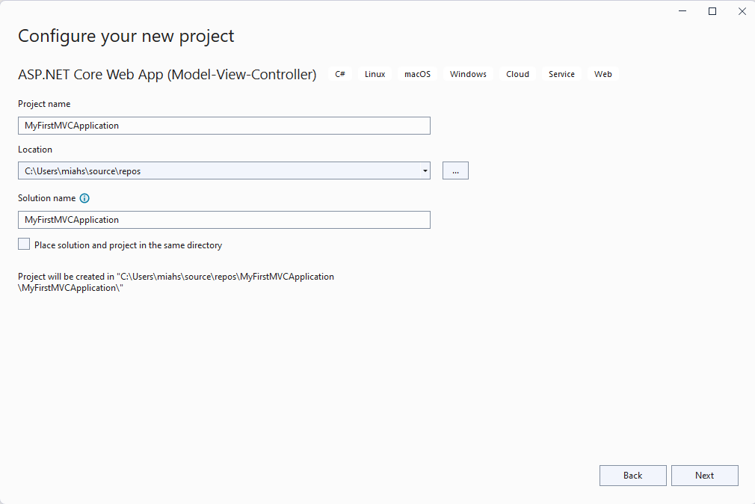
Name the Project Appropriately

Slide 6
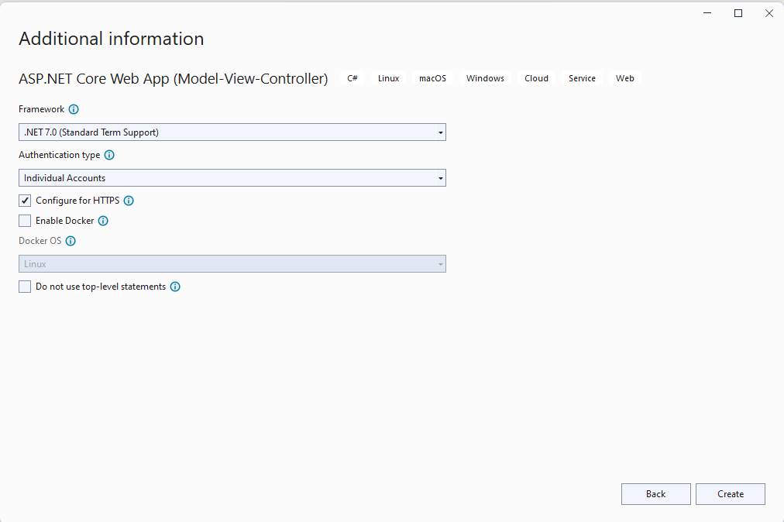
Change Authentication Type to Individual Accounts and Framework to .NET 7.0

Slide 7
Click Create

Slide 8
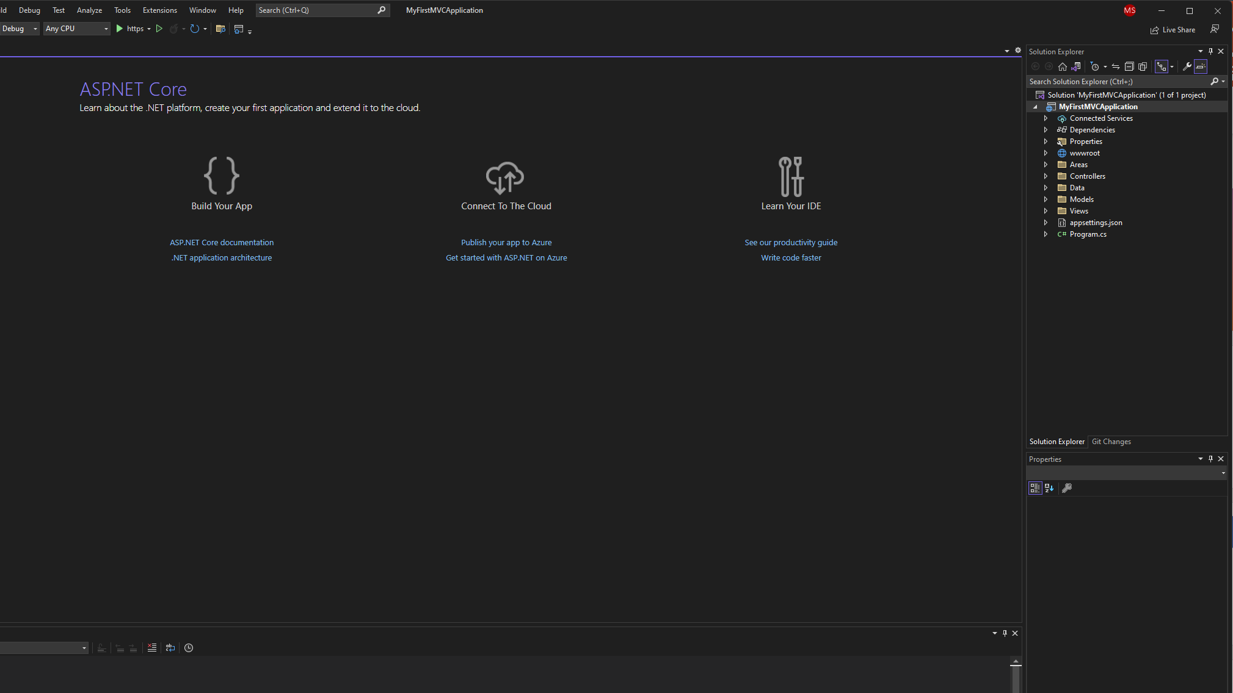
New MVC Solution Created

Slide 9
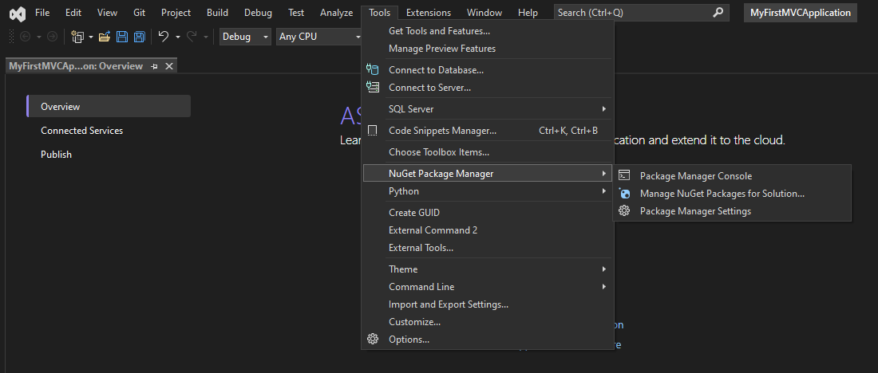
Open Package Manager Console

Slide 10
In the Console, Install the Packages
Install
Install-Package Microsoft.VisualStudio.Web.CodeGeneration.Design
Install
Install-Package Microsoft.EntityFrameworkCore.Design
Install
Install-Package Microsoft.EntityFrameworkCore.SqlServer

Slide 11
Now run your first migration to set up the login system

Slide 12
Open PMC (Package Manager Console)

Slide 13
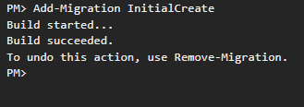
Run the Following Command -> Add-Migration InitialCreate

Slide 14
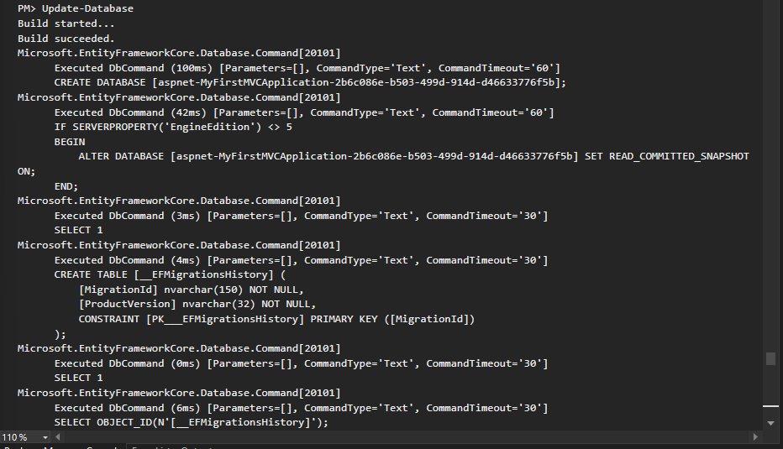
Now run the Update Database Command

Slide 15
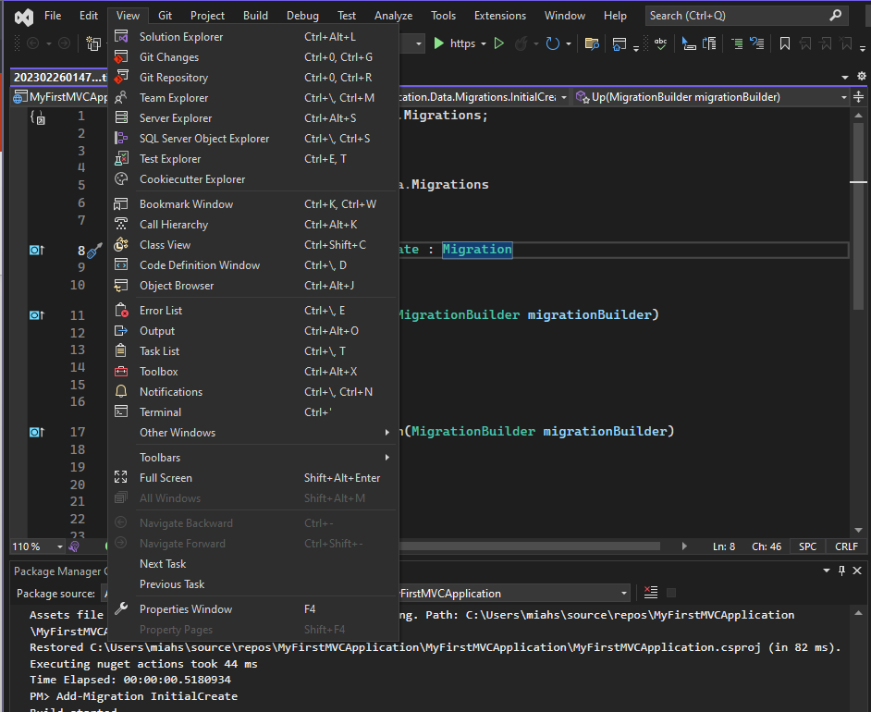
Open the Database Design using the SqlServerExplorer to check if it has been made

Slide 16
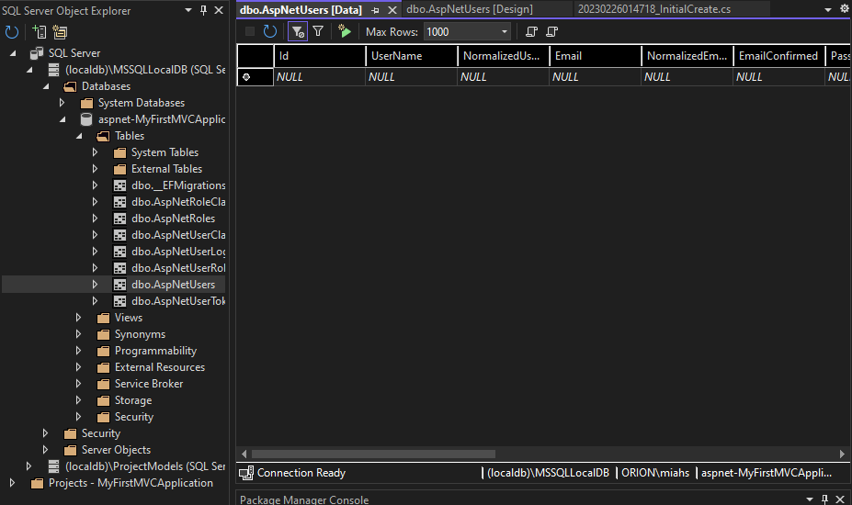
SQL Server Object Explorer

Slide 17
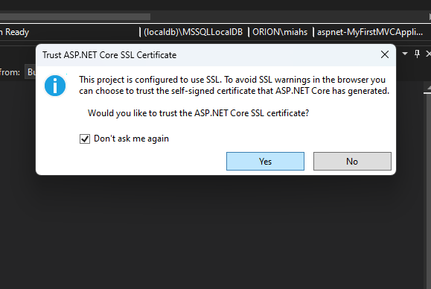
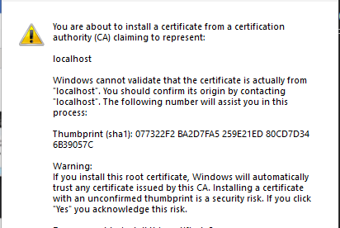
Run the Application and test the Register and Login Pages. Accept and select yes to the following warnings.

Slide 18
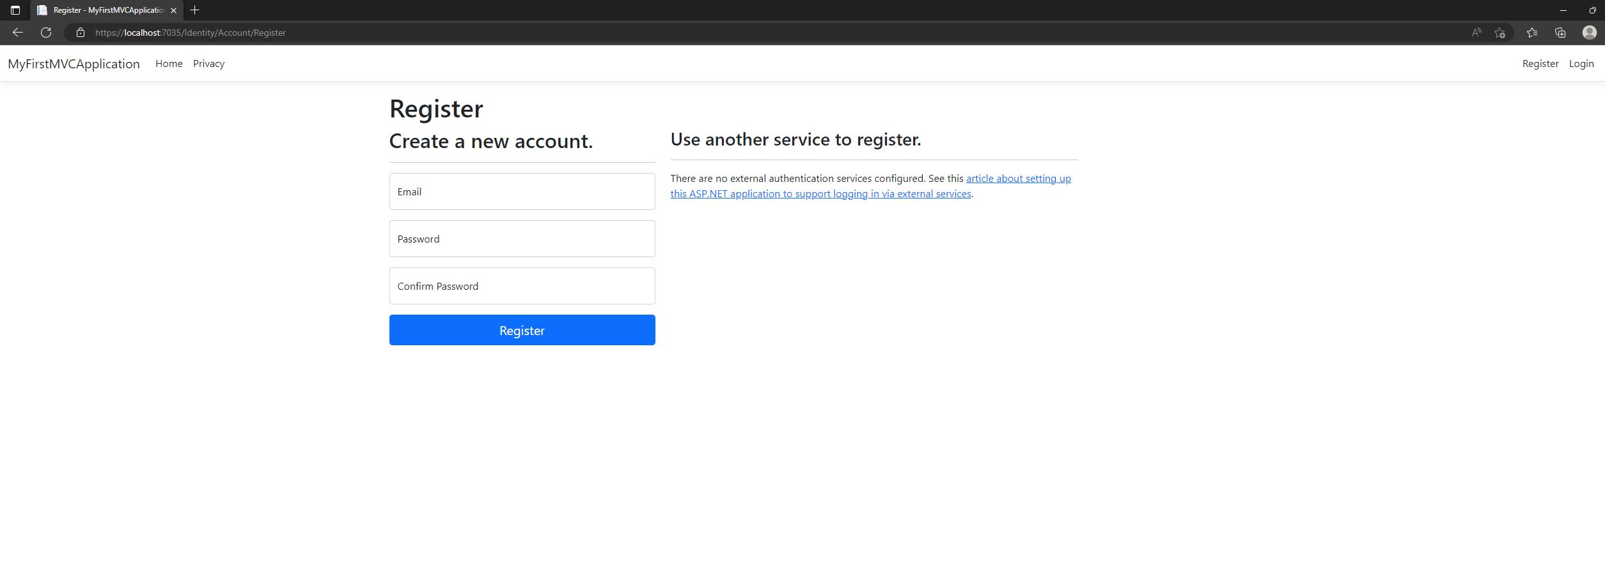
Register Page

Slide 19
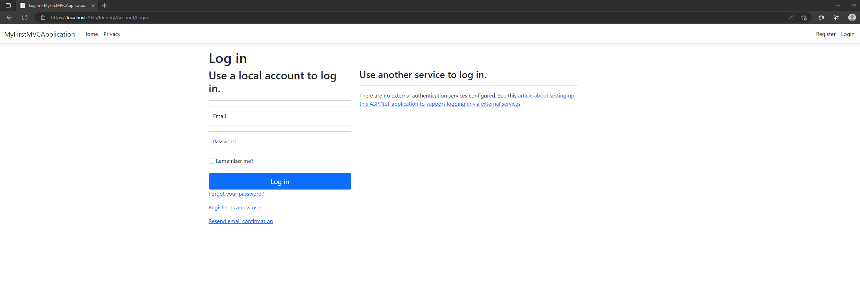
Login Page

Slide 20

Now before we can edit these 2 pages, we need to Scaffold the Identity

Slide 21
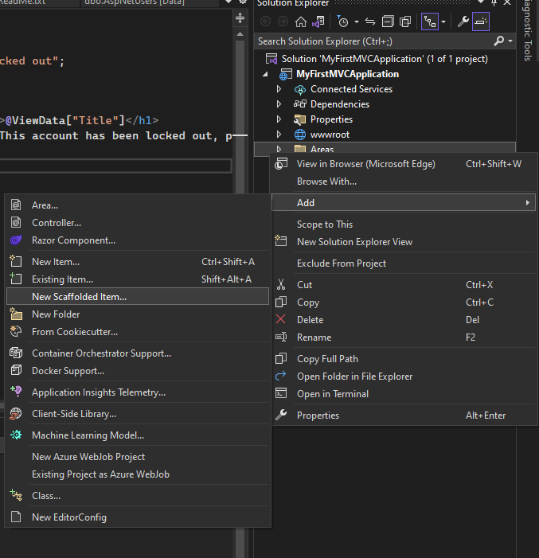
Right Click the Areas Folder -> Add New Scaffolded Item

Slide 22
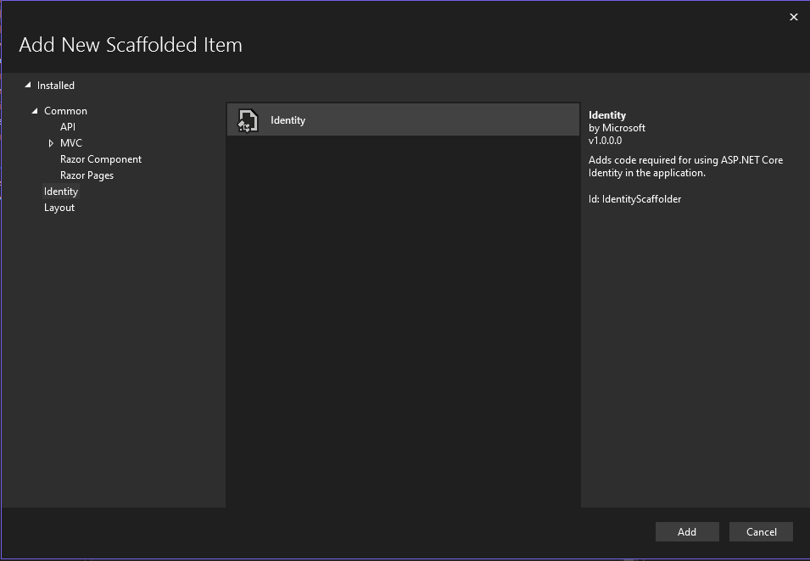
Select Identity -> Add

Slide 23
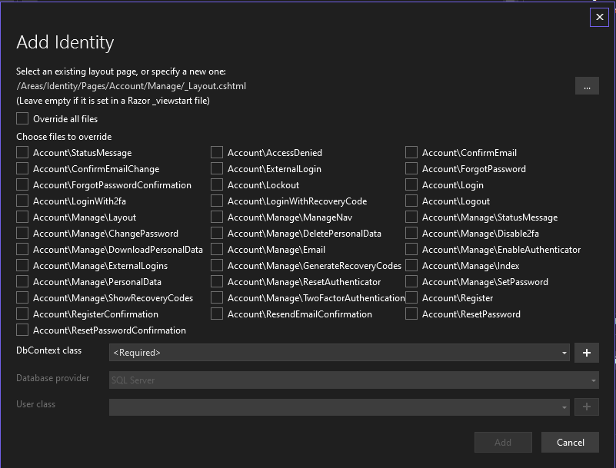
Should have this screen

Slide 24
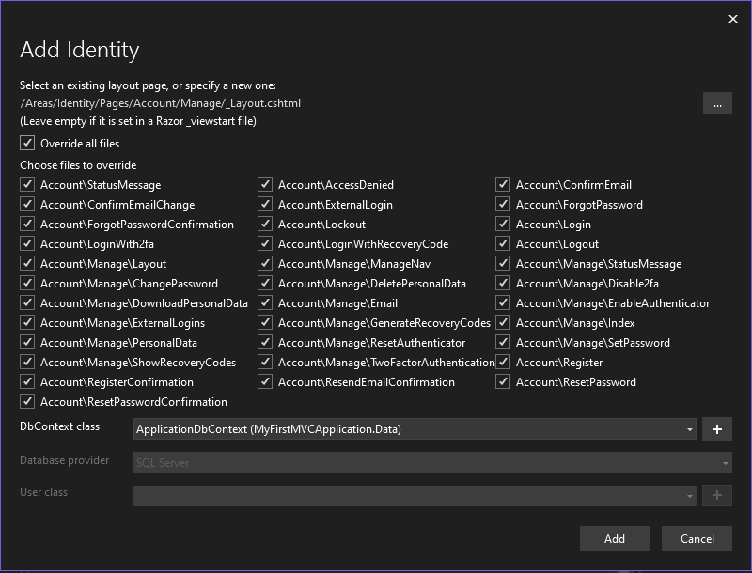
Select Override all files and then select the DbContext class that you have already made

Slide 25
Click Add and let it run

Slide 26
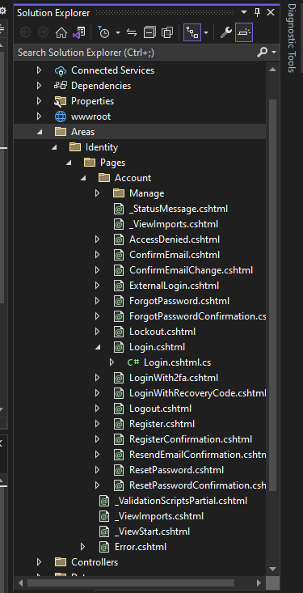
Areas Folder should now have more pages and for each page have the cshtml file and inside that the C# file

Slide 27
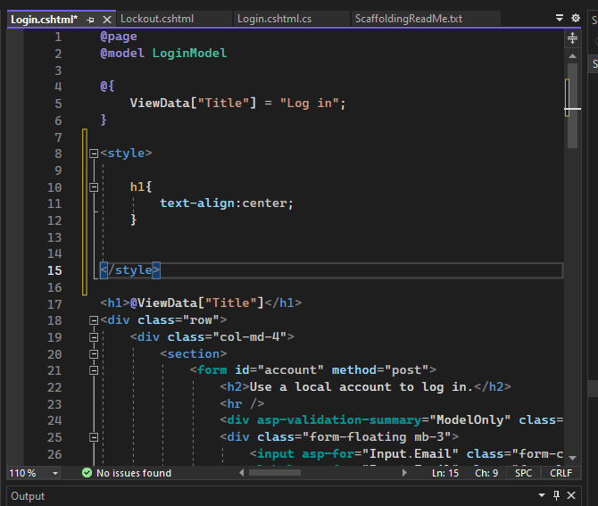
You can now edit these pages as you see fit, if you want to add customized CSS, then do so in the cshtml file in a style tag at the top like below

Slide 28

Creating Models, Controllers and Views

Slide 29

For any views, that will not have a backend -> create a new folder inside the Views Folder and create normal html files inside as you would

Slide 30
Creating Views with a Backend

Slide 31
First Create the Models

Slide 32
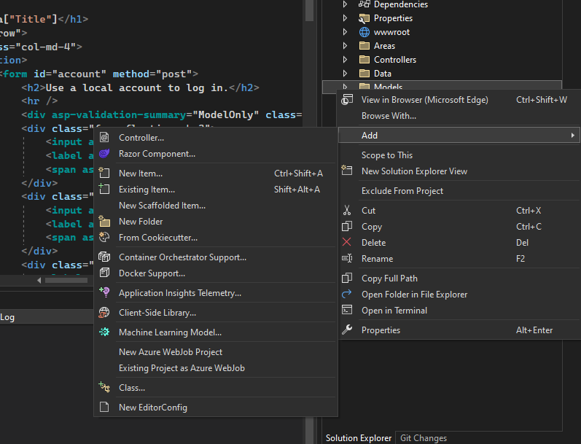
Right Click the Model Folder -> Add new Class

Slide 33
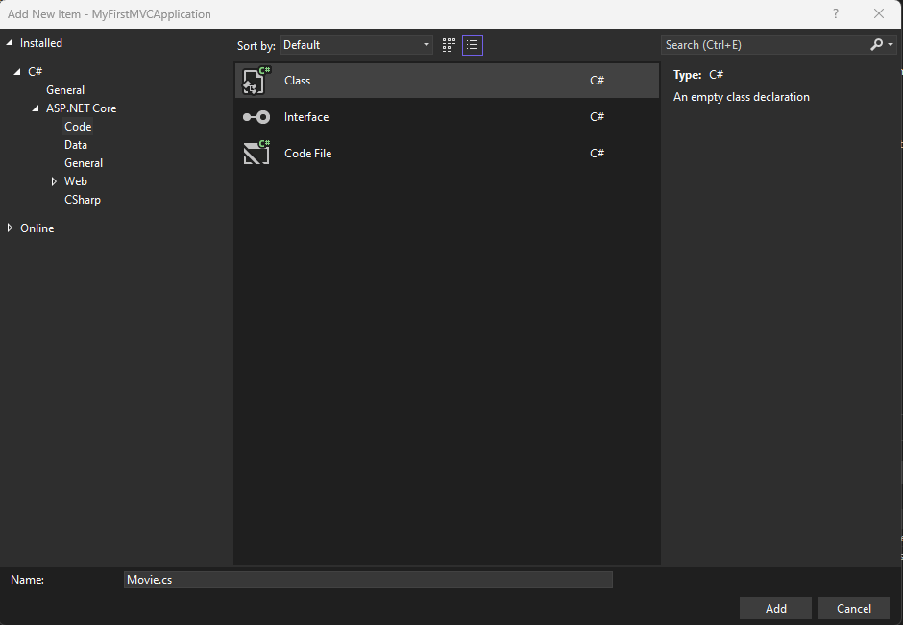
Name the Model

Slide 34
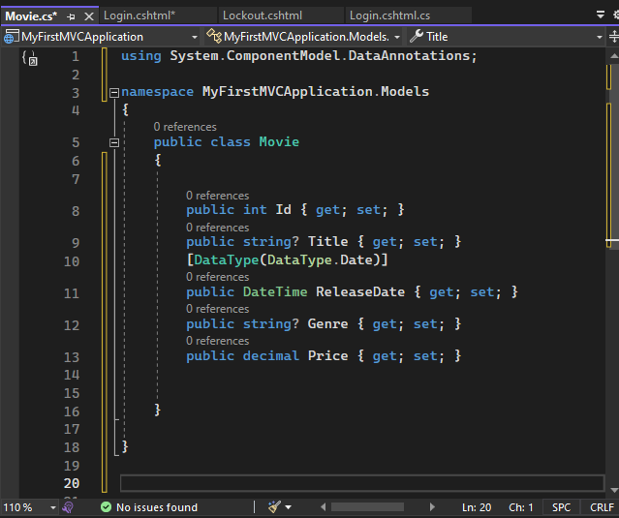
Fill and Complete the Model -> Make sure it has an ID

Slide 35
Once the Models are completed, ready to scaffold

Slide 36
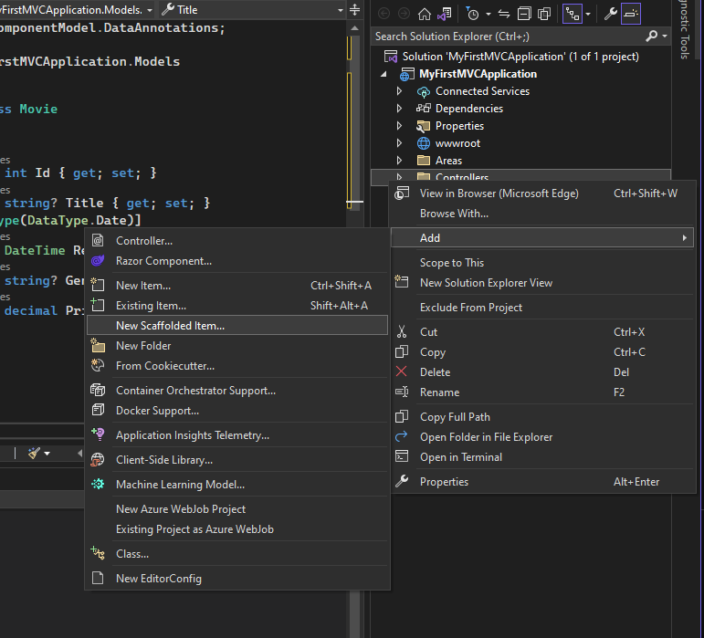
Right Click Controllers Folder -> Add New Scaffolded Item

Slide 37
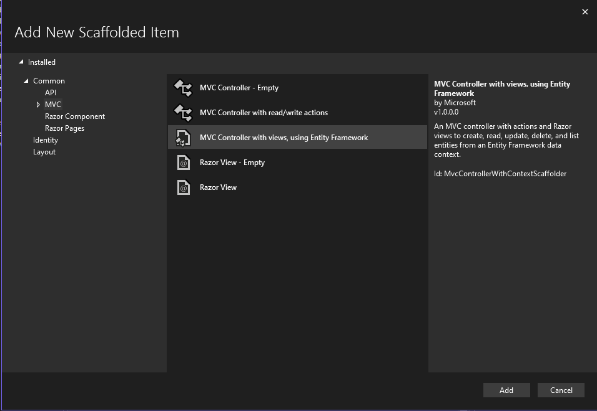
Select MVC on the left, then MVC Controller with Views, using Entity Framework. Select Add

Slide 38
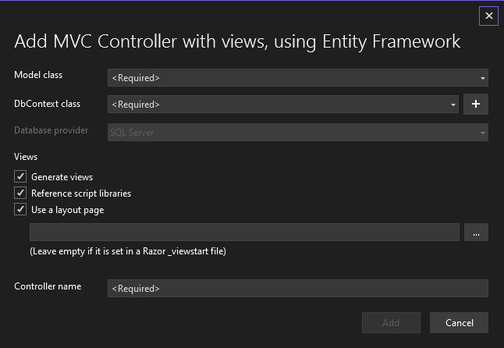
Should be presented with this screen

Slide 39
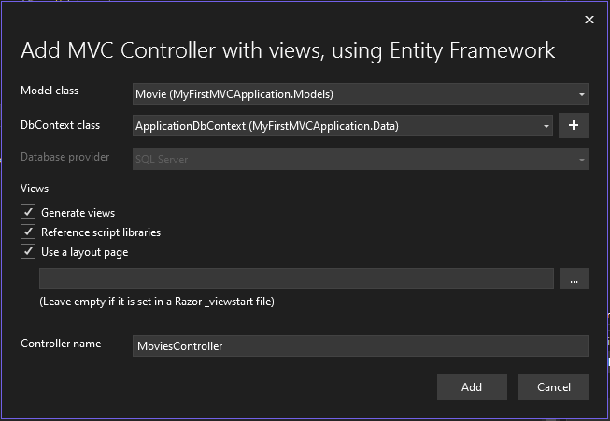
Select the Model in the first dropdown, select the DbContext in the second. Leave the rest as it is, and press Add

Slide 40
This will Create all the files, but the link is not made yet. Must Migrate and Update Database First

Slide 41
Open Package Manager Console

Slide 42
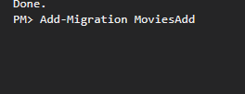
Run the Add Migration Command

Slide 43

Run the Update Database Command

Slide 44
Double check in the SQL Server Object Explorer to ensure tables are made

Slide 45
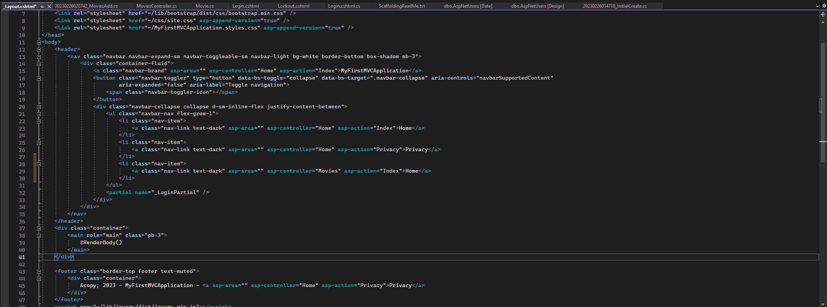
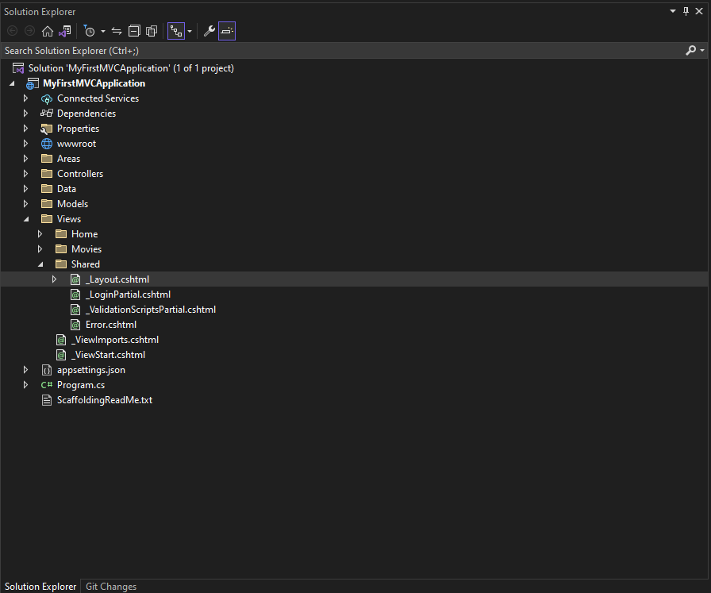
Create the Navigation Button in the layout page

Slide 46
Run the Web Application and test the page

Slide 47
Repeat this process for all the different Views you want to make for each model

Slide 48

Edit the pre-made view, delete them and create new ones where you see fit.

